Slide 1
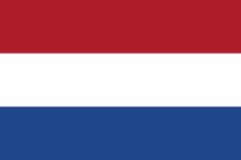
The Dutch National Flag Problem
Youssef Ahmed - 220719

Slide 2


The Problem
Given an array with elements having three distinct values
(for example 0,1,2 OR R,W,B)
the algorithm should rearrange the elements in the array in a specific order.

Slide 3
The Strategy
Divide and conquer is a problem-solving technique that involves breaking a complex problem into smaller Problems, solving them recursively, and then combining their solutions to address the original problem

Slide 4
The Algorithm in Quicksort
The Dutch National Flag can be incorporated into the partitioning step of quicksort. Instead of just partitioning elements into two groups (less than and greater than the pivot), you can partition them into three groups (less than, equal to, and greater than the pivot). This modification helps in efficiently handling duplicate elements in the array. you can achieve better performance when the array contains a lot of duplicate elements. It reduces the number of unnecessary comparisons and swaps, improving the overall efficiency of the quicksort algorithm.

Slide 5
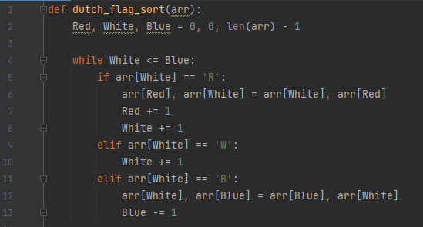
The Algorithm
The Dutch National Flag algorithm, also known as the three-way partitioning, is a sorting algorithm designed to sort an array of elements containing three distinct values in a specific order

Slide 6

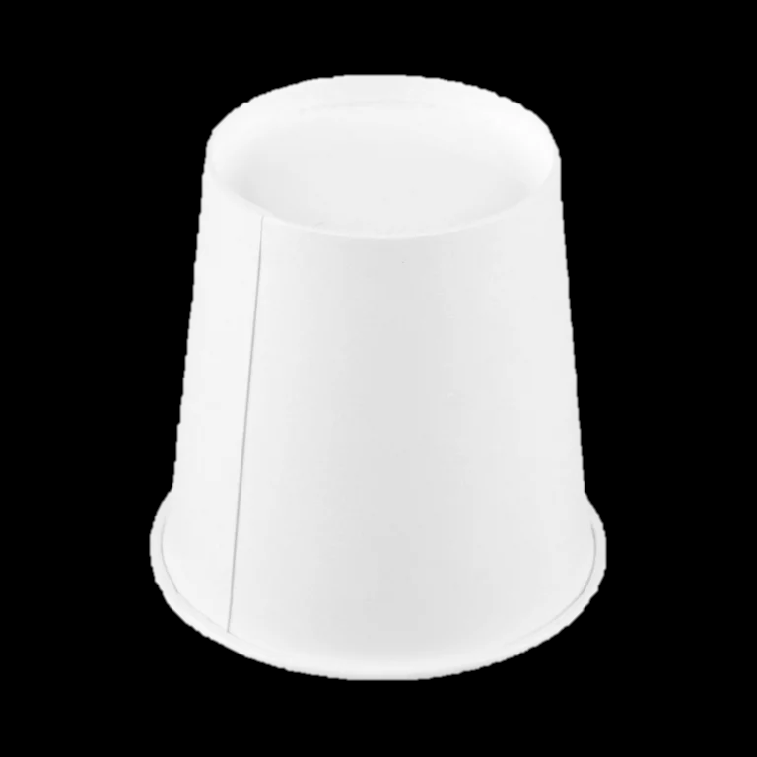
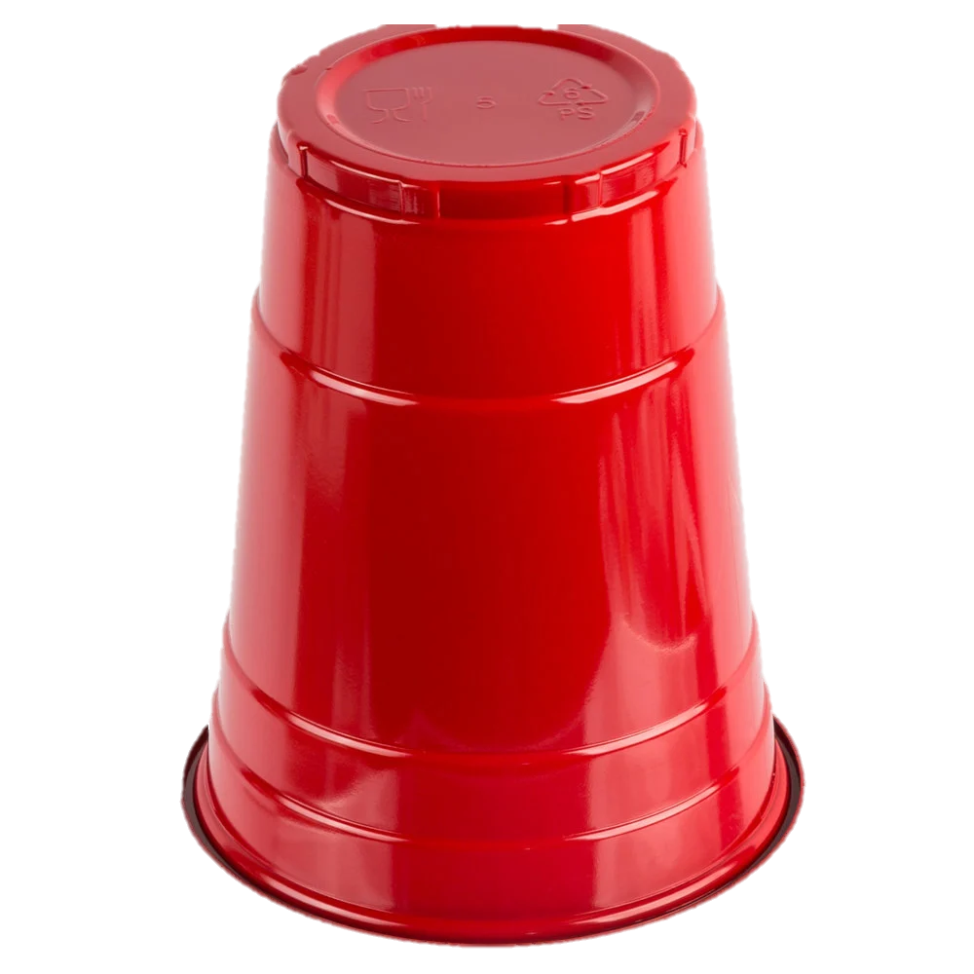
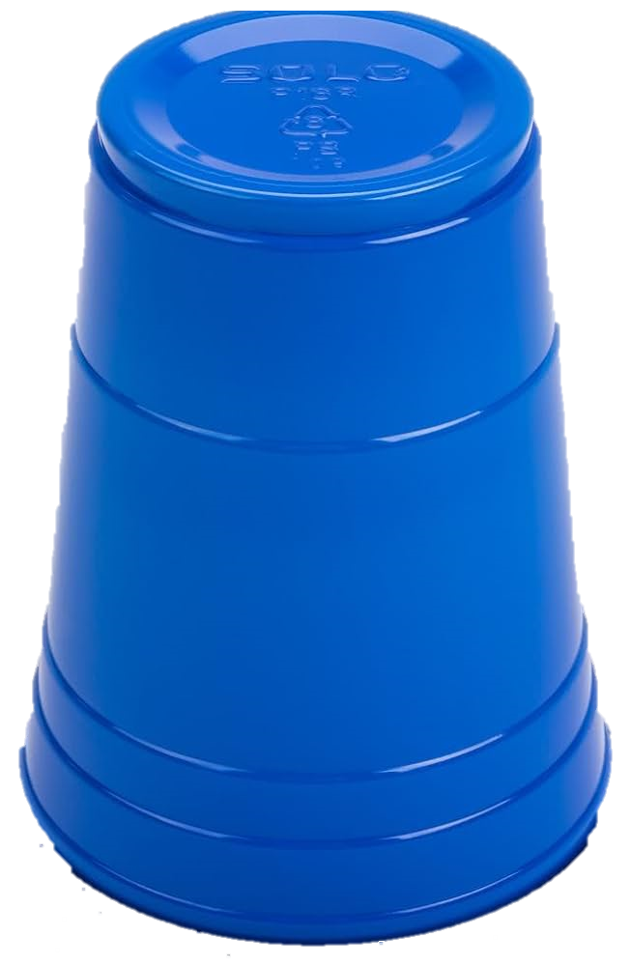
Implementation

Slide 7


Slide 8
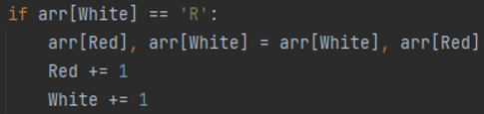

Slide 9


Slide 12


Slide 13
Analysis
n-1
T(n)= ∑ 1
white=0
T(n) = (n-1) – 0 + 1
T(n) = € o(n)

Slide 14
Best and Worst Case
Best Case
The best-case scenario occurs when the input array is already sorted according to the Dutch National Flag criteria In this case, the algorithm still goes through each element once, but it doesn't need to perform any swaps. The best-case time complexity is O(n)
Worst Case
The worst-case scenario occurs when the input array is in reverse order. Even in this case, the algorithm goes through each element once, and the number of operations is proportional to the size of the array. The worst-case time complexity is O(n)

Slide 15
The End Thank You

